Slide 1
Guaranteed Loan Program Update January 2025
USDA/Farm Service Agency

Slide 2

Presenters:
Calvin Greer, Sr. Loan Officer, LMD
Heather Laubenthal, Sr. Loan Officer, LMD

Slide 3

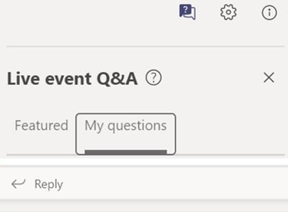
Microsoft Teams Live Event
One–Direction Broadcast: As an attendee, you are not able to share your audio or video feed.
Q&A: Participants may ask questions during the Live Event using the Q&A feature. To see all questions posted, toggle between the Featured and My Questions tab.
Meeting Recording: This event is being recorded. A copy of this recording will be available on the FSA website under Guaranteed Loans – Lender Toolkit.

Slide 4
Improvements to Guaranteed Farm Loan Programs
Enhancing FLP Rule
Preferred Lender Program Improvements
IT Modernization
Guaranteed Loan Evaluation Form

Slide 5
Enhancing FLP Rule: Notable Rule
Effective as of September 25, 2024
Guaranteed Program Changes
Subordinations
Restructuring
Transfer and Assumption
Cashflow flexibilities
Training available on lender toolkit

Slide 6
Improving Program Delivery
Monitoring applications without decisions
Streamlined options for simplified applications
Discussions with Federal Agencies
Structured evaluation process to improve consistency

Slide 7
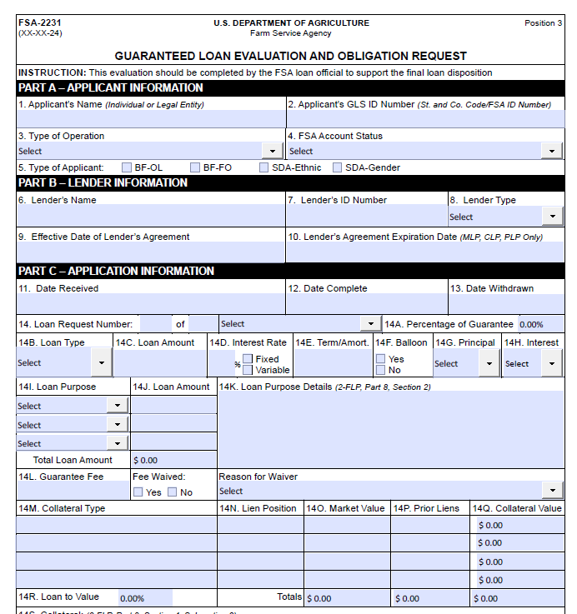
Standardizing Guaranteed Loan Evaluations
Revised to standardize evaluations
Pilot testing underway
Rollout anticipated 1st quarter of 2025

Slide 8
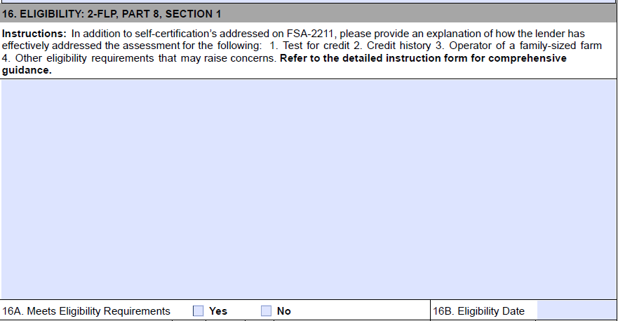
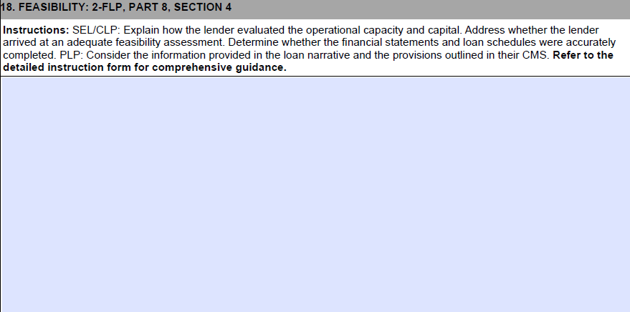
Function of the FSA-2231
Assess each loan to determine its quality, risk level, and compliance
Identifies any issues related to the lender’s documentation or compliance
Provides Loan Officials with a standardized mechanism to evaluate guaranteed loan requests

Slide 9
Objectives of the revised FSA-2231
Consistency: A standardized form ensures that all relevant information is consistently captured, reducing errors and discrepancies ( Improving continuity between states).
Efficiency: Having a single form simplifies data entry, review, and analysis. It saves time for evaluators.
Compliance: A common form ensures equity in compliance with regulations and guidelines in how applications are evaluated for each lender.
Risk Assessment: A uniform format promotes transparency by making the evaluation criteria clear and accessible to all stakeholders.
Reporting and Analysis: Standardized data allows for better reporting, trend analysis, and decision-making at both state and national levels.

Slide 10
What’s new in the Preferred Lender Program (PLP)
2024
Relaxed loan volume standards for established PLP lenders
2025
Exploring additional authorities for PLP lenders

Slide 11
IT Modernization: Loan Assistance Tool (LAT)
Educational Tool
Individualized Experience
Direct and Guaranteed Loans
Producer and Lender Focused
Forms with Instructions
Lender Toolkit

Slide 12
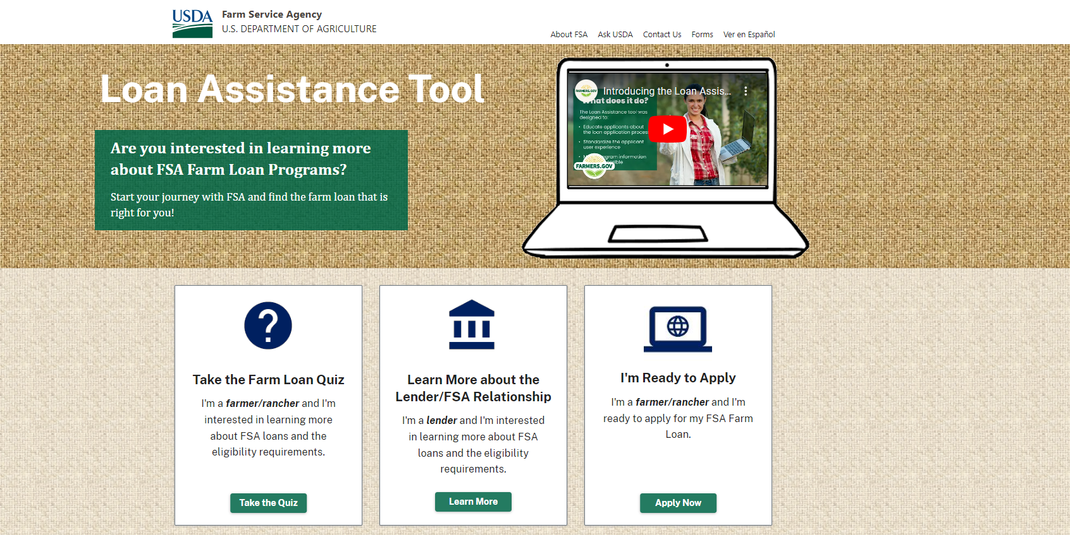
Live Demo

Slide 13
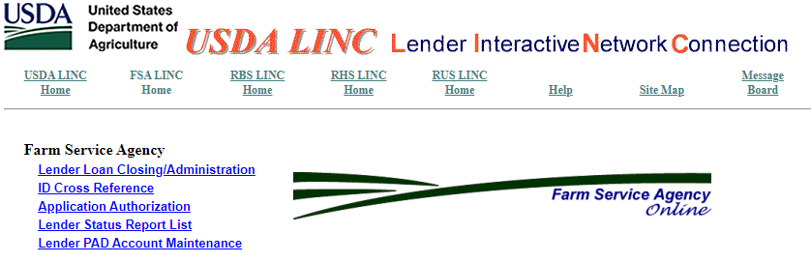
Lender Interactive Network Connection (LINC)
FSA LINC Homepage: FSA LINC Home (usda.gov)

Slide 14

Lender Interactive Network Connection (LINC)
LINC is an online portal through which FSA guaranteed lenders can complete the following transactions:
Loan Closing
Semi-Annual Status Reports
Default Status Reports
Pre-Authorized Debit (PAD) Account Maintenance
Manage user access (for certain users)

Slide 15

Obtaining Access to LINC
Pre-Requisites:
Level 2 eAuth Account via Login.gov
Establishment of user role(s) after Level 2 Account creation
  Certain user roles require FSA action to be established
  Other user roles can be established by an Administrator on the lender’s staff

Slide 16

User Role Details
The Lender Administrator – Allows the user to grant lender or branch roles to other users assigned to any of the lender’s branches. Also, allows the user to enter transactions for all the lender’s branches.
The Branch Administrator – Allows the user to grant branch roles for only the lender branch(es) for which the user is associated. Also, allows the user to enter transactions for only the lender branch(es) for which the user is associated.
The Lender Representative – Allows the user to enter transactions for all the lender’s branches.
The Branch Representative – Allows the user to enter transactions for only the lender branch(es) for which the user is associated.

Slide 17
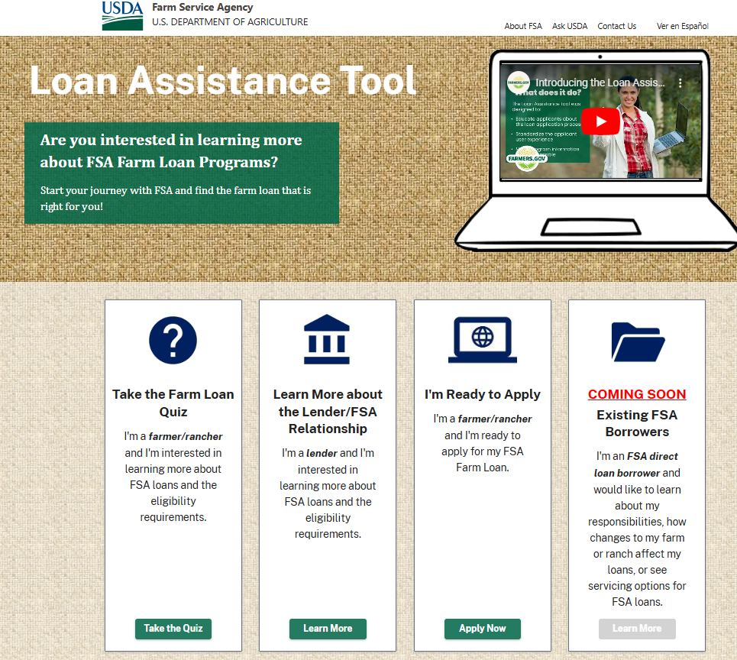
Resources
FSA LINC Homepage: FSA LINC Home (usda.gov)
Loan Assistance Tool: https://lat.fpac.usda.gov/
Lender Toolkit:
https://www.fsa.usda.gov/resources/programs/guaranteed-farm-loans/lender-toolkit
Idea for quarterly training? Email heather.laubenthal@usda.gov

Slide 18

Thank you for joining us.

